Slide 1
Constructing Equity Portfolio
Team Members Group No: 61 Panel Number:2
S.No | Reg.No | Name of the Student | Section
1 | CB.EN.U4CSE18125 | Karthik Desai | CSE B
2 | CB.EN.U4CSE18160 | V.S.V.Akanksh | CSE B
3 | CB.EN.U4CSE18235 | Kushagra Kumar Agrawal | CSE C
4 | CB.EN.U4CSE18244 | Reddybathuni Mohan | CSE C
Project Advisors:
Dr. (Col.) Kumar P. N. / Professor / CSE
Dr. A. Senthil Kumar /Assistant Professor (SG)-Finance /ASB

Slide 2
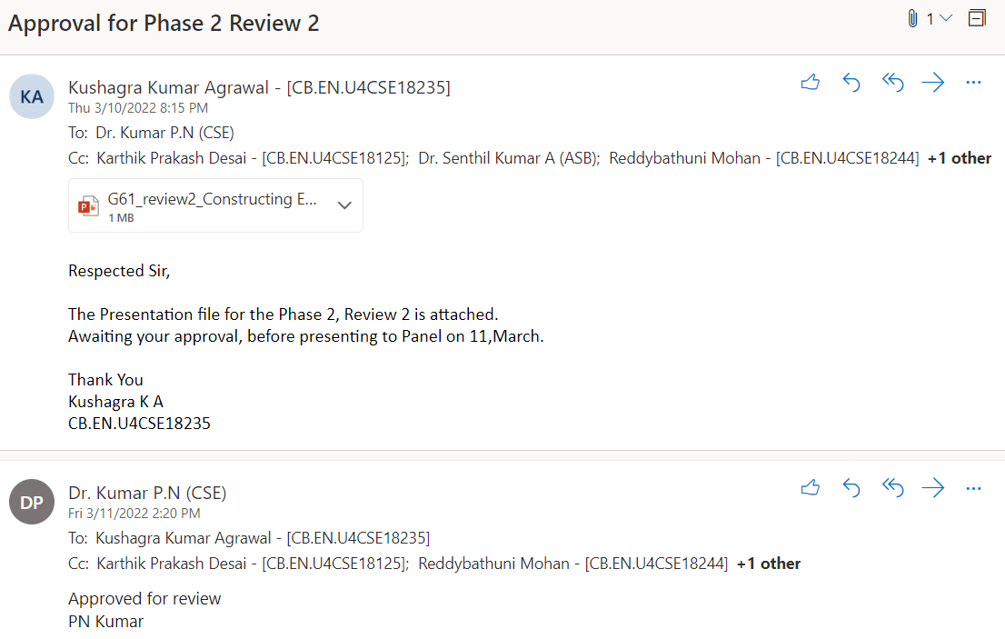
Guide approval mail

Slide 3
Problem Definition
Constructing equity portfolios using the prominent optimization algorithms

Slide 4
Literature Survey
Hanhong Zhu, Yi Wang, Kesheng Wang, Yun Chen, “Particle Swarm Optimization (PSO) for the constrained portfolio optimization problem”, Expert Systems with Applications, Volume 38, Issue 8, 2011
a. Inference:
A direct approach of PSO on the stock assets with various number of stocks in portfolio. Sharpe
ratio and efficient frontier are used in restricted and unrestricted(short selling allowed).
b. Research gap:
Hybrid version of PSO can be applied for the same problem.
Kambiz Forqandoost Haqiqi and Tohid Kazemi,”Ant Colony Optimization Approach to Portfolio Optimization – A Lingo Companion”.International Journal of Trade, Economics and Finance, Vol. 3, No. 2, April 2012.
a. Inference:
To chose the good solution path which has been taken the most. The good quality solution probability remains high, if that path is taken often and other path probability diminishes.
b. Research Gap:
More attempts are to be made to improve ACO algorithm towards a more applicable one. .

Slide 5
Literature Survey
3. Saranya, K. and Prasanna, P. K. (2014). “Portfolio selection and optimization with higher
moments: Evidence from the indian stock market.”Asia-Pacific Financial Mar-kets, 21(2), 133–149.
Inference:
It has taken four terms Mean, Variance, Skewness, Kurtosis. Maximize the Mean and Skewness,
whereas minimize Variance and Kurtosis.
Research Gap:
Compare to other financial market and on recovering market.

Slide 6
Literature Survey
4. Boris Georgiev.”Constrained Mean-Variance Portfolio Optimization with Alternative Return
Estimation”. International Atlantic Economic Society 2014.
Inference:
i. In portfolio analysis one of the main problems is to obtain sound predictions of expected
future returns and covariance among the assets.
ii. An alternative model for the estimation of expected returns is proposed.
iii. Both suggested portfolios (Maximized Sharpe and information ratio) yield positive results
and provide evidence for superior returns, compared to other alternative investment
options such as holding a market index or investing in a risk-free asset.
Research gap:
i. The final choice between the two strategies depends on the risk preferences of the investor.

Slide 7
Literature Survey
5. Jithin Eapen,Abhishek Verma,Doina Bein.”Novel Deep Learning Model with CNN and
Bi-Directional LSTM for Improved Stock Market Index Prediction”. IEEE (Institute of Electrical
and Electronics Engineers) Xplore 2019.
Inference:
i. CNN layers when combined with Bidirectional LSTM show improved prediction performance
from the temporal sequence as compared to the traditional SVM regressor.
ii. Multiple pipelines of deep layers that concatenate the best of the results from three individual
pipelines performs better than single pipeline model.
b. Research gap:
i. Future research would apply deep learning toward combining model for predicting price
and trends with sentiment analysis on new data to get even better stock price index
prediction.

Slide 8
Literature Survey
6. Anita Yadav, C K Jha , Aditi Sharan.”Optimizing LSTM for time series prediction in Indian stock
market”. International Conference on Computational Intelligence and Data Science (ICCIDS 2019).
Inference:
I. The performance of LSTM is highly dependent on choice of hyper parameters.
ii. Data is fed to LSTM in batches
iii. An important hyper parameter in configuring LSTM is the number of neural layers.
Research gap:
i. The present work is limited to tuning the basic LSTM architecture. Different types of LSTM models
can be similarly tuned.
7. Akhter Mohiuddin Rather, Arun Agarwal, V.N.Sastry. “Recurrent neural network and a hybrid model for
prediction of stock return”. Expert Systems with Application, Vol 42, Issue 6, 15 April 2015..
Inference:
a. Hybrid of 2 models: linear(autoregressive moving average mode) and Nonlinear(RNN).
b. The proposed hybrid prediction model merges predictions obtained from these two prediction
based models.
Research gap :
a. Can be further enhanced by testing it in different areas such as engineering sciences, exchange
rate risk etc
b. To minimize computation time of RNN.

Slide 9
Literature Survey
8. Saud Almahdi, Steve Y. Yang, “A constrained portfolio trading system using particle swarm algorithm
and recurrent reinforcement learning”, Expert Systems with Applications, Volume 130, 2019.
a. Inference:
PSO was applied on stock market dataset with constraints as sharpe ratio, sortino ratio, calmer ratio
and a comparative analysis was made. It was concluded that PSO with Calmer ratio fits the best.
b. Research gap:
Effect of deep learning methods such as the deep recurrent reinforcement learning on the constrained
portfolio optimization where an improved recurrent network may help better capture price movement
Patterns.
9. Shile Chen And Changjun Zhou . “Stock Prediction Based on Genetic Algorithm Feature Selection and Long Short-Term Memory Neural Network ”.College of Mathematics and Computer Science , December 2020.
a. Inference:
The combination of Genetic Algorithm and LSTM. There are three Research methodologies : i) Genetic
Algorithm , ii) LSTM , iii) GA-LSTM TWO-STAGE STOCK PRICE PREDICTION MODEL
b. Research gap:
Trial and error is usually adopted instead of systematic method.

Slide 10
Literature Survey
10. Adil Moghar,Mhamed Hamiche,”Stock Market Prediction Using LSTM Recurrent Neural Network”,(IWSMAI
2020)
a. Inference:
The main objective of this paper is to see in which precision a Machine learning algorithm can predict and
how much the epochs can improve our model. The paper aims to use an ML algorithm based on LSTM
RNN to forecast the adjusted closing prices for a portfolio of assets, the main objective here is to obtain
the most accurate trained algorithm, to predict future values for our portfolio.
b. Research Gap:
The model was being trained with variable epochs. The data being considered as univariate however
no research with multivariate data combinations with epochs.

Slide 11
Literature Survey
11. Arushi Gupta,Smriti Srivastava,“Comparative Analysis of Ant Colony and Particle Swarm
Optimization Algorithms for Distance Optimization”,(ICITETM 2020)
a. Inference:
Objective is to solve two distance optimization using two separate swarm intelligence
algorithms-particle swarm and ant colony. Both the algorithms analysis is compared.Any
optimization algorithm is said to be effective if it converges to global minima in less number
of iterations.Objective is to find shortest path or distance between two vertices. Comparative
analysis is done using PSO and ACO. ACO is a probability based method on the behaviour
of ants to find the shortest path set by other ants.
b. Research Gap :
Application of ACO and PSO in stock market optimization.
c. Conclusion:
Results for both ACO and PSO were both demonstrated.It is observed that the ACO
algorithm has a lower square of error (0.2 at 80 iterations) and an overall better
performance.

Slide 12
Literature Survey
12. Jui-ChungHung,“Adaptive Fuzzy-GARCH model applied to forecasting the volatility of stock
markets using Particle Swarm Optimisation”, (2020)
a. Inference:
Objective is to forecast the stock market data for Taiwan, Germany and Japan using an
adaptive Fuzzy-Garch model and optimize it using Particle Swarm Optimization.
b. Research gap:
The fuzzy-garch algorithm can be applied in Indian stock market and appended with an
ACO/PSO optimization.
c. Conclusion:
This method brings best results for market with high-frequency, time-varying volatility. It
offers significant improvements in forecasting ability. The PSO searches for peaks within
the parameter space, so its not necessary to specify any initial conditions to improve the
result.

Slide 13
Literature Survey
13. Carlos Betancourt, Wen-Hui Chen,”Deep reinforcement learning for portfolio management of
markets with a dynamic number of assets”, Expert Systems with Applications, Volume
164,2021.
a. Inference:
In the dynamic scenario they tried to implement the portfolio management. There is a time
session in which the trading happens after that the market is evaluated and compared with
last time session. This way the market trend of cryptocurrency is analyzed and
reinforcement learning takes place.
b. Research gap:
The concept can be applied to stock market.

Slide 14
Literature Survey
14. Senthilkumar, A., Namboothiri, A., & Rajeev, S. (2021). Does portfolio optimization favor sector
or broad market investments? Journal of Public Affairs, e02752.
a. Inference:
Optimizing the portfolio there are variety of combinations, a portfolio can be of intra-sector
assets or inter sector portfolio, in intra-sector portfolio and inter-sector portfolio are compared.
A comparison is made with between the Markowitz model and Sharpe’s model.
b. Research gap:
Explore how weights change under different economic conditions .Use of advance Machine
learning algorithm.To expand it in global context

Slide 15
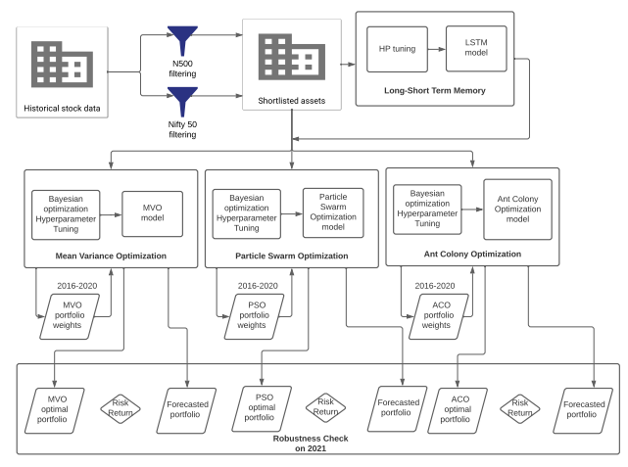
Architecture diagram

Slide 16
List all the Modules
Sharpe and Sortino Filtering
LSTM
Mean- Variance Optimization
Particle Swarm Optimization
Ant Colony Optimization
Implementing using static data (2016-2021)
Implementing using dynamic data(sliding window)(2016-2022)
Passive Nifty50 Index risks and returns

Slide 17
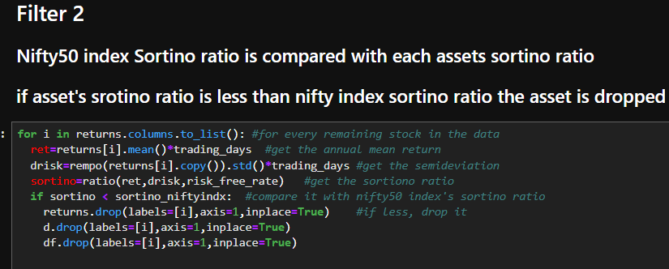
Module 1 : Nifty Filtering
Data Collection:
  Historical data is collected from Yahoo finance.
Nifty Filtering:
  Data is filtered using the below 2 criteria.
  Data is available for throughout the time period.
  Sortino ratio of stock must be greater than Sortino Ratio of the Nifty index.(because stock with downside volatility are considered if greater than whole nifty index sortino ratio.

Slide 18
Module 2 (Ant Colony Optimization)
Ants deposit pheromone as they walk and find their route by walking along the pheromone deposition. Density of pheromone increases as they walk back to source with food. Pheromone deposition is proportional to the number of ants.
Returns for sortino for positive returns are nulled as sortino measures the assets changes from a downfall deviation. Sharpe takes both positive and negative returns.
Covariance of annualised returns are calculated for evaluating standard deviation.
Random probability are initialised and based off these values , the ants determine the next pheromone update by updation formula. To avoid initial pheromone preferability, an evaporation update is done to make sure the ants search for the best fitness values globally.
The global weights are the final component for the parts of investment and fitness values determine the accuracy of each weighted combination of assets.
We have performed Bayesian optimization for the hyperparameter tuning in ACO since they maximise the loss function and returns globally highest parameters. Framework for Bayesian hyperparameter optimization- Optuna

Slide 19
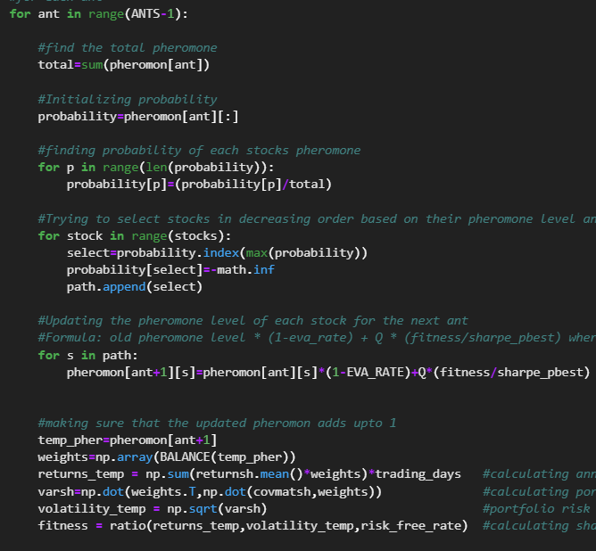
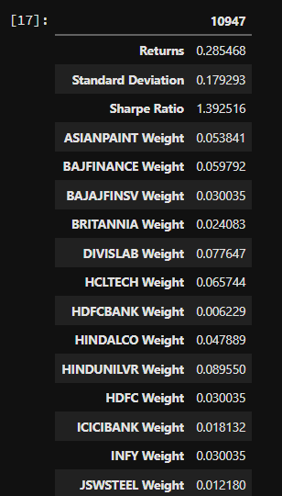
Module 2 (Ant Colony Optimization) :output

Slide 20
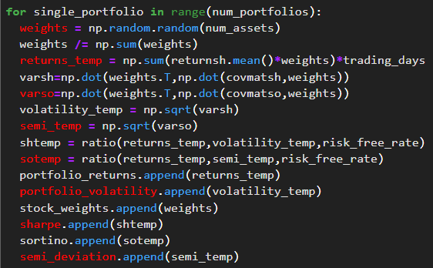
Module 3 (Mean Variance Optimization)
Variables are initialized and assigned which are required for MVO. Such as
For each stock daily return data frame is created
Trading days is calculated
Annualized covariance matrix for sharpe and sortino ratios are made
Weights for each stock is allocated which sum up to 1
Returns and risk are calculated
The MVO is run for many iterations(50000) for each iteration the sharpe ratio and sortino ratio portfolio are stored as dataframe.

Slide 21
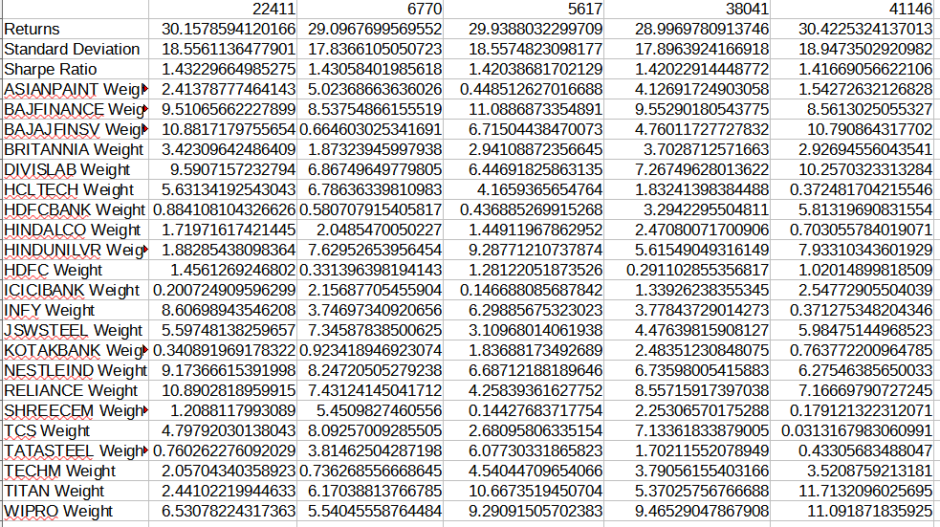
Module 3 (Mean Variance Optimization):Output

Slide 22
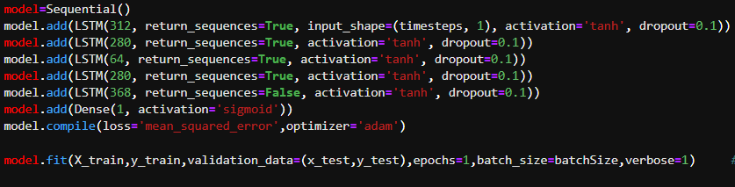
Module 4(Long Short Term Memory)
The preprocessed data is taken and split into training and testing.
Hyperparameter tuning for LSTM. Hyperparameters are:
Timestep,
Batch
epoch
1. LSTM model is run on train data:
1.1Robustness check is done using (MSE,RMSE,R_square,MAPE)
2. LSTM model is run on test data and validates itself with real data.
2.1 Robustness check is done using (MSE,RMSE,R_square,MAPE)

Slide 23
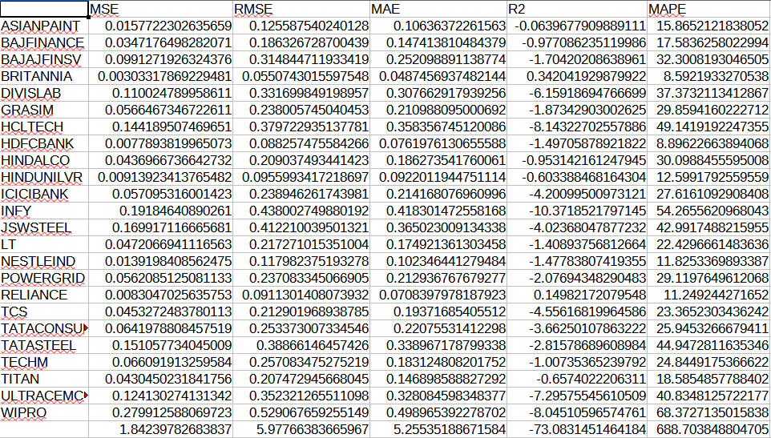
Module 4 (Long Short Term Memory) : Output

Slide 24
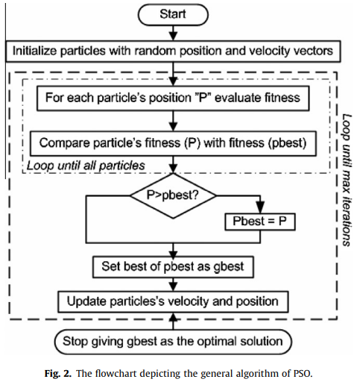
Module 5 (Particle Swarm Optimization)
Variables are initialized and assigned which are required for PSO. Such as
For each stock daily return dataframe is created
Trading days is calculated
Annualized covariance matrix for sharpe and sortino ratios are made
Weights for each stock is allocated which sum up to 1
Returns and risk are calculated
PSO Model is tuned using Bayesian optimization (for parameters as Swarm size,iterations)
There is fitness function check and particles’ velocity and position update formula for finding the optimum solution over each iterations

Slide 25
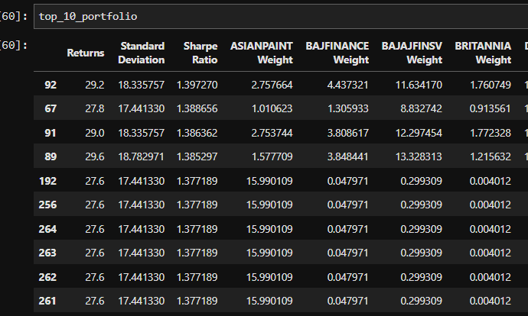
Particle Swarm Optimization:Output

Slide 26
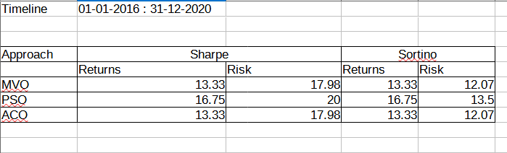
Module 6( Nifty50 index ) :output
It is the risk and return of Nifty 50 index stocks,
It will be used for benchmark testing against our portfolios build by optimization algorithm

Slide 27
Work plan / Milestones
September2021
October 2021
November2021
December 2021
MVO
implemented
tested on sample data
PSO
implemented
tested on sample data
ACO
implemented
tested on sample data
Literature survey
Filtering data
January 2022
February 2022
March 2022
April 2022
LSTM
Tuning and implementation
Use of Static Data 2016-2021
to get the results
using data Dynamically (sliding window for results.
Robustness test
validation and final results

Slide 28
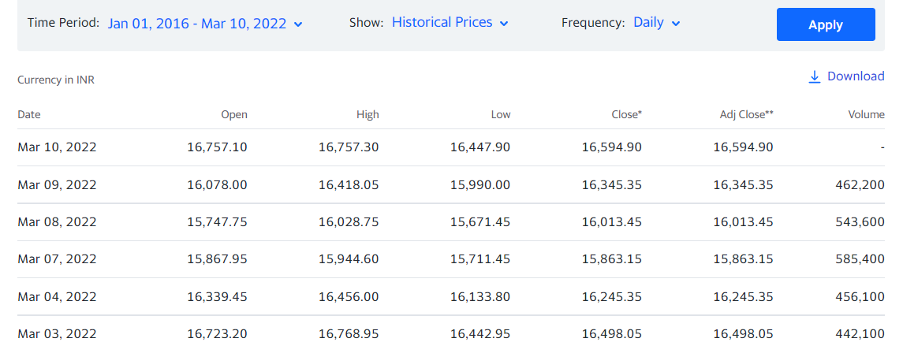
Dataset description
Dataset is taken from Yahoo Finance, for various stocks(at least 25 stockes) over 5 years period.
Python library of yahoo finance has been used by us to get the latest data.

Slide 29
Software/Hardware Requirements
1. Python3 - Coding Language.
2. Jupyter Lab/Notebook/Colab - Coding environment.
3. Python Packages - NSEpy, Numpy, Pandas, Scikit learn, Tensorflow, Keras, Optuna
4. Tableau - Visualization
5. GitLab - Collaboration and Version control.
6. Amrita HPC

Slide 30
References ( in IEEE format )
[1] Hanhong Zhu, Yi Wang, Kesheng Wang, Yun Chen, Particle Swarm Optimization (PSO) for the constrained portfolio optimization problem, Expert Systems with Applications, Volume 38, Issue 8, 2011,
[2]Saud Almahdi, Steve Y. Yang, A constrained portfolio trading system using particle swarm algorithm and recurrent reinforcement learning, Expert Systems with Applications, Volume 130, 2019
[3] Carlos Betancourt, Wen-Hui Chen,Deep reinforcement learning for portfolio management of markets with a dynamic number of assets, Expert Systems with Applications, Volume 164,2021
[4] Akhter Mohiuddin Rather, Arun Agarwal, V.N.Sastry. “Recurrent neural network and a hybrid model for prediction of stock return”. Expert Systems with Application, Vol 42, Issue 6, 15 April 2015..
[5] Shile Chen And Changjun Zhou . “Stock Prediction Based on Genetic Algorithm Feature Selection and Long Short-Term Memory Neural Network ”.College of Mathematics and Computer Science , December 2020.
[6] Anita Yadav, C K Jha , Aditi Sharan.”Optimizing LSTM for time series prediction in Indian stock market”. International Conference on Computational Intelligence and Data Science (ICCIDS 2019).

Slide 31
References ( in IEEE format )
[7] Jithin Eapen,Abhishek Verma,Doina Bein.”Novel Deep Learning Model with CNN and Bi-Directional LSTM for Improved Stock Market Index Prediction”. IEEE (Institute of Electrical and Electronics Engineers) Xplore 2019
[8] Murtaza Roondiwala , Harshal Patel, Shraddha Varma. “Predicting Stock Prices Using LSTM”.International Journal of Science and Research (IJSR),Volume 6 Issue 4, April 2017.
[9] Adil Moghar,Mhamed Hamiche“Stock Market Prediction Using LSTM Recurrent Neural Network”.(IWSMAI 2020)
[10] Kambiz Forqandoost Haqiqi and Tohid Kazemi,”Ant Colony Optimization Approach to Portfolio Optimization – A Lingo Companion”.International Journal of Trade, Economics and Finance, Vol. 3, No. 2, April 2012
[11]Arushi Gupta,Smriti Srivastava,“Comparative Analysis of Ant Colony and Particle Swarm
Optimization Algorithms for Distance Optimization”,(ICITETM 2020)
[12] Saranya, K. and Prasanna, P. K. (2014). “Portfolio selection and optimization with higher moments: Evidence from the indian stock market.”Asia-Pacific Financial Mar-kets, 21(2), 133–149

Slide 32
References ( in IEEE format )
[13] Boris Georgiev.”Constrained Mean-Variance Portfolio Optimization with Alternative Return Estimation”. International Atlantic Economic Society 2014.
[14] Senthilkumar, A., Namboothiri, A., & Rajeev, S. (2021). Does portfolio optimization favor sector or broad market investments? Journal of Public Affairs, e02752. https://doi.org/10.1002/pa.2752

Slide 33
THANK YOU

